Slide 1

Chapter 12
Multiple Access
12.<number>
Copyright © The McGraw-Hill Companies, Inc. Permission required for reproduction or display.

Slide 2

Figure 12.1 Data link layer divided into two functionality-oriented sublayers
12.<number>

Slide 3

Figure 12.2 Taxonomy of multiple-access protocols discussed in this chapter
12.<number>

Slide 4
12-1 RANDOM ACCESS
In random access or contention methods, no station is superior to another station and none is assigned the control over another. No station permits, or does not permit, another station to send. At each instance, a station that has data to send uses a procedure defined by the protocol to make a decision on whether or not to send.
Topics discussed in this section:
ALOHA
Carrier Sense Multiple Access
Carrier Sense Multiple Access with Collision Detection
Carrier Sense Multiple Access with Collision Avoidance
12.<number>

Slide 5
ALOHA
ALOHA was developed at the University of Hawaii in early 1970.
It was designed for wireless LAN, but it can be used on any shared medium.
When a station(device) sends data, another station may attempt to do so at the same time, collisions may occur, and data may get destroyed.
Types
  Pure ALOHA
  Slotted ALOHA
12.<number>

Slide 6

Pure ALOHA
Four stations compete for the shared medium.
Collisions between frame happen even if one bit of the frames coexist in the channel at the same time.
12.<number>

Slide 7
Pure ALOHA
The pure ALOHA protocol relies on acknowledgments from the receiver.
If the acknowledgment does not arrive after a time-out period, the station assumes that the frame (or the acknowledgment) has been destroyed and resends the frame.
If all these stations try to resend their frames after the time-out, the frames will collide again.
  Solution:
  Each station waits a random amount of time (backoff time: TB) before resending its frame.
  After a maximum number of retransmission attempts Kmax, a station must give up and try later.
  Time-out time = 2 × round trip time
12.<number>

Slide 8
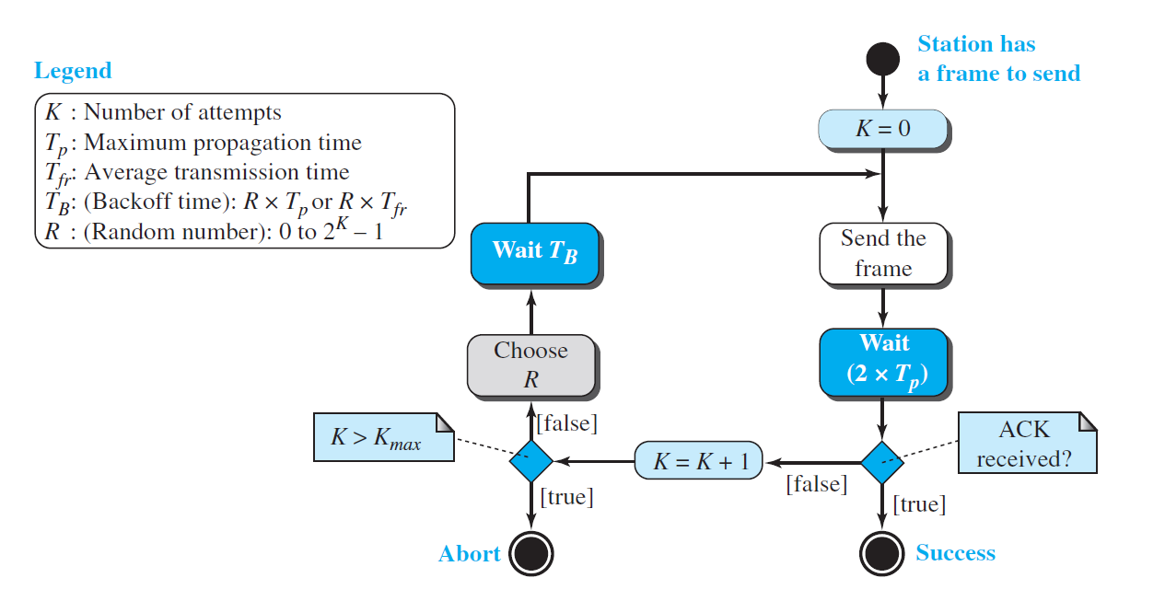
Pure ALOHA
12.<number>

Slide 9
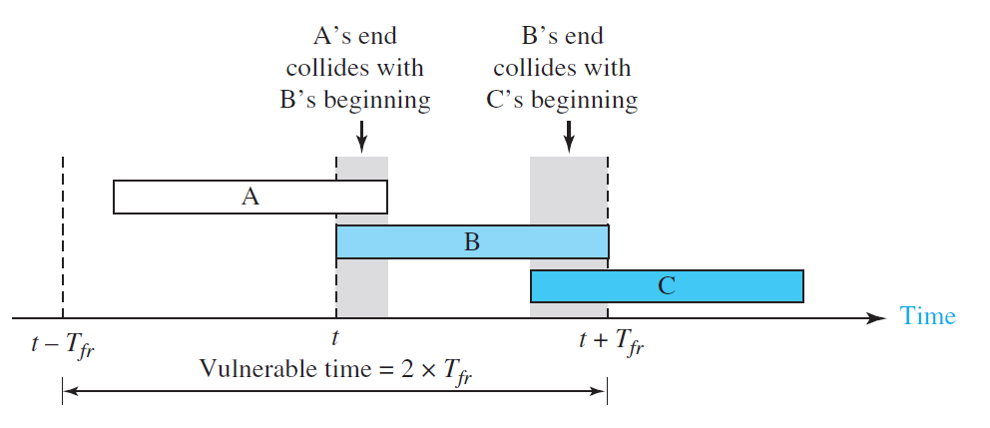
Vulnerable time in Pure ALOHA
The length of time in which there is a possibility of collision.
T_{fr} refers to the transmission time
Vulnerable time = 2 × T_{fr}
12.<number>

Slide 10
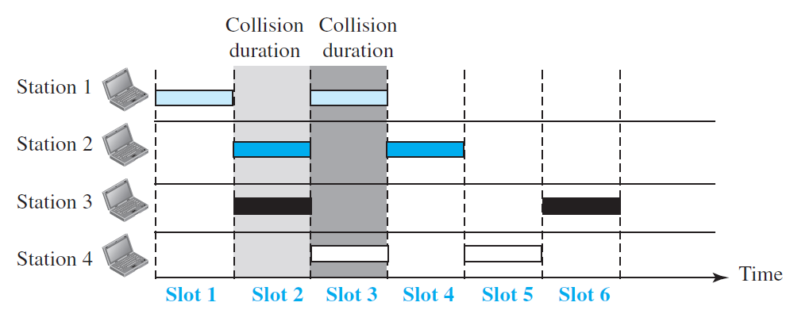
Slotted ALOHA
In pure ALOHA a station may send soon after another station has started or just before another station has finished resulting in a collision.
Slotted ALOHA was invented to improve the efficiency of pure ALOHA.
Time divide into slots of Tfr seconds and stations forced send only at the beginning of the time slot.

Slide 11
Slotted ALOHA
If a station misses a slot, it must wait until the next slot to transmit.
This ensures that another station which had transmitted in the previous slot finishes transmission.

Slide 12
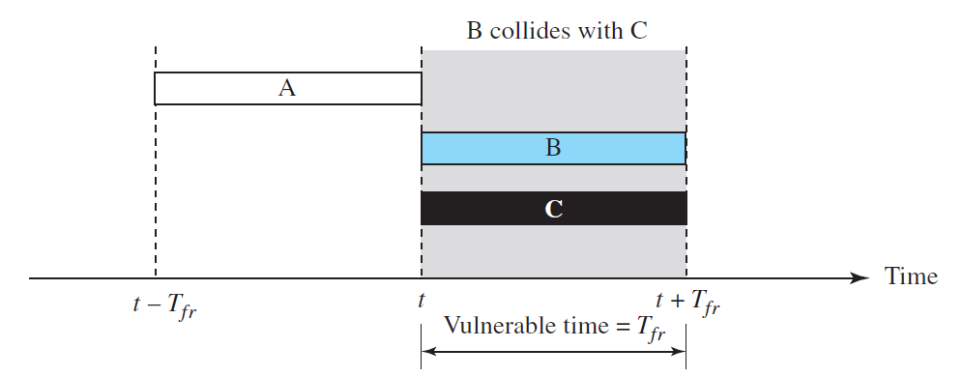
Vulnerable time for Slotted ALOHA
Vulnerable time = T_{fr}

Slide 13
Carrier Sense Multiple Access (CSMA)
Tries to reduce the number of collisions by making stations sense the medium before transmitting.
CSMA can reduce the possibility of collision, but it cannot eliminate it.
The possibility of collision still exists because of propagation delay as it takes time for the first bit of a frame to reach every station and for every station to sense it.
A station may sense the medium and find it idle, only because the first bit sent by another station has not yet been received.

Slide 14
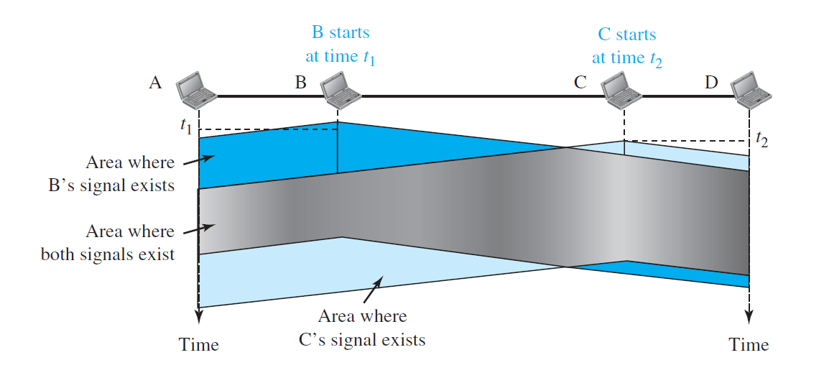
Collision in CSMA
At time t₁, station B senses the medium and finds it idle, so it sends a frame.
At time t₂ (t₂ > t₁), station C senses the medium and finds it idle because, at this time, the first bits from station B have not reached station C.
Station C also sends a frame, both the frames collide.

Slide 15

Vulnerable time in CSMA
Station A sends a frame at time t₁ which arrives at the furthest station D after T_{p}, the propagation time
12.<number>

Slide 16
Actions to be taken when the channel is idle and when busy
Three persistence methods are defined
  1-persistent method
  Non-persistent method
  p-persistent method
12.<number>

Slide 17

1-persistent method
  A station continuously senses the medium.
  If found idle, it transmits immediately.
  Has higher chance of collision as two frames may find the medium idle simultaneously and transmit immediately.
12.<number>

Slide 18
Non-persistent method
If the line is idle, the sender sends immediately.
If not, it waits a random amount of time and then senses the line again.
Reduces the chance of collision as it is unlikely that two or more stations will wait the same amount of time and retry to send simultaneously.
Is less efficient because the medium remains idle when there may be frames to send.
12.<number>

Slide 19
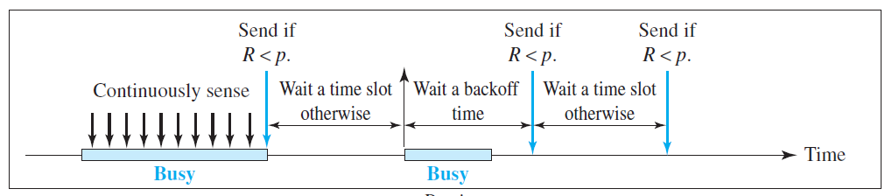
p-persistent method
Channel divided into time slots, each slot equal to or greater than maximum propagation time.
When a station finds a medium idle following steps followed: -
  With probability p, the station sends its frame.
  With probability q = 1 − p, the station waits for the beginning of the next time slot and checks the line again.
    If line is idle, it goes to step 1.
    If line is busy, it backs off.
12.<number>

Slide 20

Figure Flow diagram for three persistence methods
12.<number>

Slide 21
CSMA/CD
Carrier sense multiple access with collision detection (CSMA/CD) augments CSMA to detect collisions.
A station monitors the medium after it sends a frame to see if the transmission was successful. If, a collision is detected, the frame is sent again.
12.<number>

Slide 22

Collision of the first bit in CSMA/CD
At time t₁, station A sends the bits of its frame.
At time t₂, station C has not yet sensed the first bit sent by A. It starts sending the bits in its frame, which propagate both to the left and to the right.
Collision occurs sometime after time t₂.
12.<number>

Slide 23
Collision of the first bit in CSMA/CD
Station C detects a collision at time t₃ when it receives the first bit of A’s frame. It immediately aborts transmission.
Station A detects collision at time t₄ when it receives the first bit of C’s frame; it also immediately aborts transmission.
12.<number>

Slide 24

Figure 12.13 Collision and abortion in CSMA/CD
12.<number>

Slide 25

Figure 12.14 Flow diagram for the CSMA/CD
12.<number>

Slide 26

Figure 12.16 Timing in CSMA/CA
12.<number>

Slide 27

Note
In CSMA/CA, the IFS can also be used to define the priority of a station or a frame.
12.<number>

Slide 28
Note
In CSMA/CA, if the station finds the channel busy, it does not restart the timer of the contention window;
it stops the timer and restarts it when the channel becomes idle.
12.<number>

Slide 29

Figure 12.17 Flow diagram for CSMA/CA
12.<number>

Slide 30
12-2 CONTROLLED ACCESS
In controlled access, the stations consult one another to find which station has the right to send. A station cannot send unless it has been authorized by other stations. We discuss three popular controlled-access methods.
Topics discussed in this section:
Reservation
Polling
Token Passing
12.<number>

Slide 31

Figure 12.18 Reservation access method
12.<number>

Slide 32

Figure 12.19 Select and poll functions in polling access method
12.<number>

Slide 33

Figure 12.20 Logical ring and physical topology in token-passing access method
12.<number>

Slide 34
12-3 CHANNELIZATION
Channelization is a multiple-access method in which the available bandwidth of a link is shared in time, frequency, or through code, between different stations. In this section, we discuss three channelization protocols.
Topics discussed in this section:
Frequency-Division Multiple Access (FDMA)
Time-Division Multiple Access (TDMA)
Code-Division Multiple Access (CDMA)
12.<number>

Slide 35
Note
We see the application of all these methods in Chapter 16 when
we discuss cellular phone systems.
12.<number>

Slide 36

Figure 12.21 Frequency-division multiple access (FDMA)
12.<number>

Slide 37
Note
In FDMA, the available bandwidth
of the common channel is divided into bands that are separated by guard bands.
12.<number>

Slide 38

Figure 12.22 Time-division multiple access (TDMA)
12.<number>

Slide 39
Note
In TDMA, the bandwidth is just one channel that is timeshared between different stations.
12.<number>

Slide 40
Note
In CDMA, one channel carries all transmissions simultaneously.
12.<number>

Slide 41

Figure 12.23 Simple idea of communication with code
12.<number>

Slide 42
Figure 12.24 Chip sequences
12.<number>

Slide 43
Figure 12.25 Data representation in CDMA
12.<number>

Slide 44

Figure 12.26 Sharing channel in CDMA
12.<number>

Slide 45

Figure 12.27 Digital signal created by four stations in CDMA
12.<number>

Slide 46

Figure 12.28 Decoding of the composite signal for one in CDMA
12.<number>

Slide 47

Figure 12.29 General rule and examples of creating Walsh tables
12.<number>

Slide 48
Note
The number of sequences in a Walsh table needs to be N = 2^{m}.
12.<number>

Slide 49
Example 12.6
Find the chips for a network with
a. Two stations b. Four stations
Solution
We can use the rows of W2 and W4 in Figure 12.29:
a. For a two-station network, we have
[+1 +1] and [+1 −1].
b. For a four-station network we have
[+1 +1 +1 +1], [+1 −1 +1 −1],
[+1 +1 −1 −1], and [+1 −1 −1 +1].
12.<number>

Slide 50
Example 12.7
What is the number of sequences if we have 90 stations in our network?
Solution
The number of sequences needs to be 2^{m}. We need to choose m = 7 and N = 2⁷ or 128. We can then use 90
of the sequences as the chips.
12.<number>

Slide 51
Example 12.8
Prove that a receiving station can get the data sent by a specific sender if it multiplies the entire data on the channel by the sender’s chip code and then divides it by the number of stations.
Solution
Let us prove this for the first station, using our previous four-station example. We can say that the data on the channel
D = (d1 ⋅ c1 + d2 ⋅ c2 + d3 ⋅ c3 + d4 ⋅ c4).
The receiver which wants to get the data sent by station 1 multiplies these data by c1.
12.<number>

Slide 52

Example 12.8 (continued)
When we divide the result by N, we get d1 .
12.<number>

